Slide 1
EIE 411 Computer Organization and Architecture
MODULE 3 (Part B): Introduction to CISC and RISC

Slide 2
What is a processor ?

Slide 3
PREAMBLE
General Classification of The Architectures of Computers:
1. Harvard and Von Neumann Architecture
Examples of Harvard: Texas Instruments TMS320 processors
Examples of Von Neumann: AVR by Atmel, PIC by Microchip
2. Instruction Set Architecture (CISC and RISC)
Examples of CISC: IBM 370, Motorola 68000
Examples of RISC: ARM, MIPS

Slide 4
PREAMBLE
3. Application Based Architecture:
- Embedded architecture (e.g. ARM64, Atmel AVR)
- Microcomputer architecture (e.g. Intel IA-32, Motorola 6800, Motorola 68000, ARM64)
- Workstation/Server architecture (Intel IA-64)
- Mini/Mainframe architecture (IBM 360, IBM 370)
Note: A computer can be classified under two or more architectures.
Example: The AVR is a modified Harvard architecture 8-bit RISC single-chip Microcontroller, developed by Atmel.
*a microcontroller is a microcomputer on a single chip, used to control some device such as an automobile engine or a toy.

Slide 5
PREAMBLE
What is an Instruction Set?
Note that all computers run using very low-level commands which do some very basic functions, such as reading data, writing data, jumping to addresses, and calculating basic arithmetic and logic operations.
So the complete list of commands that can be run by a CPU is known as that computer’s instruction set. High-level languages such as C++, Fortran, must be compiled (translated) into theses low level commands in order for a program to run.

Slide 6
PREAMBLE
These low-level commands are run in a series of steps, which are synchronized with the computer’s clock.
A computer runs with precise timing dictating when instructions are fetched, decoded, executed, and stored.

Slide 7
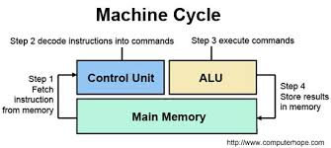
PREAMBLE
These low-level commands are run in a s

Slide 8
PREAMBLE
Some Simple Commands are:
MOV AX,3 ; Put 3 into register AX
ADD AX,2 ; Add 2 to the contents of AX
SUB AX,4 ; Subtract 4 from the contents of AX

Slide 9
Introduction to CISC and RISC
An important aspect of computer architecture is the design of the instruction set for the processor.
NOTE THAT:
The instruction set chosen for a particular computer determines the way that machine language programs are constructed.

Slide 10
Introduction to CISC and RISC
A computer with a large number of instructions is classified as a Complex Instruction Set Computer, abbreviated CISC.
In the early 1980s, a number of computer designers recommended that computers use fewer instructions with simple constructs so they can be executed much faster within the CPU without having to use memory as often. This type of computer is classifies as a Reduced Instruction Set Computer, abbreviated RISC.

Slide 11
Introduction to CISC and RISC
When designing an instruction set for a computer, we must consider not only the machine language constructs, but also the requirements imposed on the use of high-level programming languages.
The translation from high-level language to a low level language is done by the means of a compiler program.

Slide 12
Introduction to CISC and RISC
A compiler is a computer program that transforms source code written in a high-level programming language into another low-level computer language (i.e. the target language). Basically, it is the translation of a source code such as C++ into a target language such as Assembly language.
An assembler is a program that takes basic computer instructions and converts them into a pattern of bits that the computer’s processor can use to perform its basic operations.

Slide 13
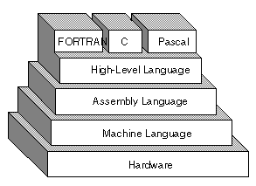
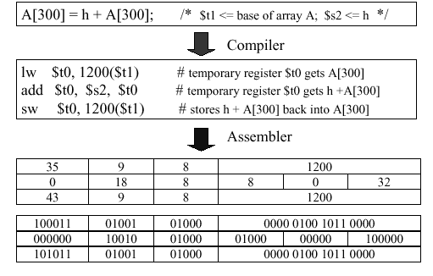
Introduction to CISC and RISC

Slide 14
CISC Architecture
Examples of CISC architectures:
Digital equipment corporation VAX computer
IBM 370 computer
Intel 386, 486, Pentium, Pentium Pro, Pentium II, Pentium III
Motorola’s 68000, 68020, 68040, etc.

Slide 15
CISC Architecture
In summary, the major characteristics of CISC architecture are:
A large number of instructions – typically from 100 to 250 instructions.
Some instructions that perform specialized tasks and are used infrequently
A large variety of addressing modes – typically from 5 to 20 different modes
Variable-length instruction formats
Instructions that manipulate operands in memory. Different machine programs can be executed on CISC machine.
CISC machines uses micro-program control unit.
CISC processors have limited number of registers.

Slide 16
RISC Architecture
Reduced Instruction Set Computer (RISC) is a type of microprocessor architecture that utilizes a small, highly-optimized set of instructions, rather than a more specialized set of instructions often found in CISC architecture.
Examples of RISC Architecture:
DEC Alpha
ARM
MIPS
Atmel AVR

Slide 17
CISC AND RISC Architecture
Most desktop or laptop computers use CISC architecture (e.g. made by Intel).
Smartphones and tablets use RISC (e.g. made be ARM).

Slide 18
CISC AND RISC Architecture
Let consider the key differences between RISC and CISC under the following area:
Instructions
Physical size
Speed
Energy consumption
Design
Cost

Slide 19
CISC AND RISC Architecture
The key differences between an Intel’s CPU and an ARM’s CPU are:
Instructions - RISC has fewer instructions than CISC. CISC generally have hundreds of instructions whereas RISC usually has a lot less. To do complex tasks, RISC CPUs must combine simple operations from their reduced instruction set. The instruction cycle in CISC is more complex than RISC, so RISC can be more efficient at performing simpler tasks.
Physical size - in order to handle all those instructions CISC CPUs are larger and require more silicon to make.
Speed - RISC CPUs run at a lower clock speed than CISC CPUs. They can perform simpler tasks more quickly than CISC, but more intensive tasks will be better on a CISC CPU. However, smartphones and tablets are generally not used to do intensive tasks like playing the most hi-spec advanced games.

Slide 20
CISC AND RISC Architecture
Energy consumption - because CISC CPUs are larger, they use more electricity. RISC CPUs are designed to use less power and they can go into 'sleep mode' when not actively processing a program.
Design - smartphones and tablets combine their processing architecture into a system on a chip (SOC). As RISC CPUs are much smaller than CISC, more functions (including the memory and other hardware) can be combined with the CPU in one chip. CISC CPUs are usually built into a system which has a heat sink and fan to cool them down. Smartphones or tablets do not have space for heat sinks or fans.
Cost - RISC CPUs use less power and are cheaper to make.

Slide 21
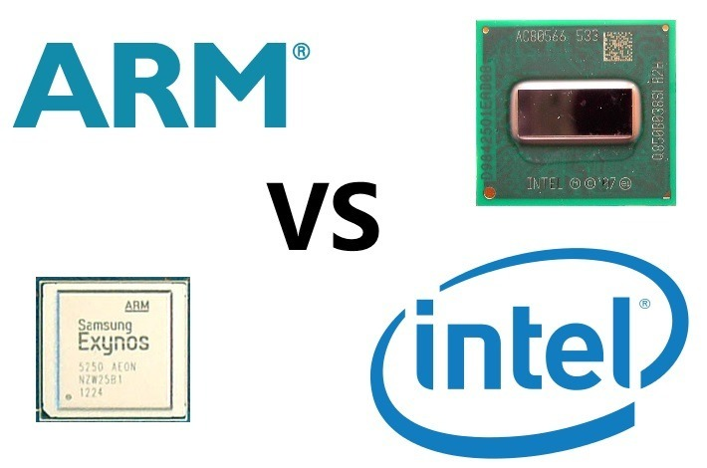
CISC AND RISC Architecture

Slide 22
CISC AND RISC Architecture
Android supports 3 different processor architectures: ARM, Intel and MIPS (originally an acronym for Microprocessor without Interlocked Pipeline Stages). The most popular and ubiquitous of these three is, without a doubt, ARM. Intel is well known primarily because of its popularity in the desktop and server markets, however on mobile it has had less of an impact.

Slide 23
CISC AND RISC Architecture
So what is the difference between an ARM processor and an Intel processor? Why is ARM the more popular choice? And does it matter what CPU is in your smartphone or tablet?
At the highest level, the first difference between an ARM CPU and an Intel CPU is that the former is RISC and the latter is a CISC. RISC instructions sets are smaller, while CISC instruction sets are larger, more complex.

Slide 24
CISC AND RISC Architecture
Multiplying Two Numbers:
The CISC Approach
The primary goal of CISC architecture is to complete a task in as few lines of assembly as possible. This is achieved by building processor hardware that is capable of understanding and executing a series of operations. For this particular task, a CISC processor would come prepared with a specific instruction ‘MULT’
MULT a, b

Slide 25
CISC AND RISC Architecture
Multiplying Two Numbers:
The RISC Approach
RISC processors only use simple instructions that can be executed within one clock cycle. Thus, the "MULT" command described above could be divided into three separate commands: "LOAD," which moves data from the memory bank to a register, "PROD," which finds the product of two operands located within the registers, and "STORE," which moves data from a register to the memory banks.

Slide 26
CISC AND RISC Architecture
In order to perform the exact series of steps described in the CISC approach, a programmer would need to code four lines of assembly:
LOAD A, a
LOAD B, b
PROD A, B
STORE a, A
At first, this may seem like a much less efficient way of completing the operation. Because there are more lines of code, more RAM is needed to store the assembly level instructions. The compiler must also perform more work to convert a high-level language statement into code of this form.

Slide 27
CISC AND RISC Architecture
However, the RISC strategy also brings some very important advantages. Because each instruction requires only one clock cycle to execute, the entire program will execute in approximately the same amount of time as the multi-cycle "MULT" command. These RISC "reduced instructions" require less transistors of hardware space than the complex instructions.

Slide 28
RISC Architecture
Although RISC system have been defined and designed in a variety of ways by different groups, the key element shared by most design are these:
• A large number of general purpose registers, or the use of compiler technology to optimize register usage.
• A limited and simple instruction set.
• An emphasis on optimizing the instruction pipeline
An analysis of the RSIC architecture begins into focus many of the important issues in computer organization and architecture.

Slide 29
The comparism of RISC and non-RISC systems is given in the Table Characteristics of some CISCs, RISCs and Supersclar Processors
 | Complex Instruction Set (CISC) Computer |  |  | Reduced Instruction Set (RISC) Computer |  | Superscaler
Characteristics | IBM 370/168 | VAX 11/780 | Intel 80486 | SPARC | MIPS R4000 | Power PC | Ultra SPARC | MIPS R10000
Year Developed | 1973 | 1978 | 1989 | 1987 | 1991 | 1993 | 1996 | 1996
Number of Instructions | 208 | 303 | 235 | 69 | 94 | 225 | -- | --
Instruction Size (bytes) | 2-6 | 2-57 | 1-11 | 4 | 4 | 4 | 4 | 4
Addressing modes | 4 | 22 | 11 | 1 | 1 | 2 | 1 | 1
Number of general-purpose registers | 16 | 16 | 8 | 40-520 | 32 | 32 | 40-520 | 32
Control Memory size (kbits) | 420 | 480 | 246 | -- | -- | -- | -- | --
Cache size (kbits) | 64 | 64 | 8 | 32 | 128 | 16-32 | 32 | 64

Slide 30
Characteristics of Reduced Instruction Set Architecture :
Although a variety of different approaches to reduce Instruction set architecture have been taken, certain characteristics are common to all of them:
One instruction per cycle.
Register to register operations.
Simple addressing modes.
Simple instruction formats.

Slide 31
1. One machine instruction per machine cycle :
A machine cycle is defined to be the time it takes to fetch two operands from registers, perform an ALU operation, and store the result in a register. With simple, one-cycle instructions there is little or no need of microcode, the machine instructions can be hardwired. Hardware implementation of control unit executes faster than the microprogrammed control, because it is not necessary to access a microprogram control store during instruction execution.

Slide 32
2. Register to register operations
With register to register operation, a simple LOAD and STORE operation is required to access the memory, because most of the operation are register to register. Generally we do not have memory to memory and mixed register/memory operation.

Slide 33
3. Simple Addressing Modes
Almost all RISC instructions use simple register addressing. For memory access only, we may include some other addressing, such as displacement and PC-relative. Once the data are fetched inside the CPU, all instruction can be performed with simple register addressing.

Slide 34
4. Simple Instruction Format
Generally in most of the RISC machine, only one or few formats are used. Instruction length is fixed and aligned on word boundaries. Field locations, especially the opcode, are fixed. With fixed fields, opcode decoding and register operand accessing can occur simultaneously. Simplified formats simplify the control unit.

Slide 35
ASSIGNMENT: To agree on submission date
1: What are the distinguishing characteristics of RISC organization?
2: Briefly explain the basic approaches used to minimize register-memory operations on RISC machines.
3: Give some reasons for shifting the paradigm from CISC to RISC.
4: Explain the concept of register window to handle the procedure calls.
5: If a circular register buffer is used to handle local variables for nested procedures, describe the approaches for handling global variables.
6: Explain the concept of graph coloring to optimize the register uses.
7: What are the differences of using large register file and cache memory?

Slide 36


